Slide 1
BATON ROUGE
Residential Market
PRESENTED BY
Tom W. Cook, MAI
Cook, Moore, Davenport and Associates

Slide 3
Outline / Summary
Look at Historical Information from 2023
Review Predictions Made For 2023
Make Predictions For 2025
Review New Developments Planned

Slide 4
Market Conditions Slowed
Dollar Volume
2022 Dollar Volume Down 9.55%
2023 Dollar Volume Down by 24.35% (at 2019 Levels )
Median Sale Price Rose by Only 1.57%
The Median rose from $239,000 to $255,000, or 6.69% in 2022
Months’ Supply Rose by 57.14%
Months' Supply in 2023 was 3.3
Months' Supply in 2022 was 2.1
Median Days on Market Rose by 280%
Median Days on Market in 2022 was 5
Median Days on Market in 2023 was 19
OVERVIEW of 2023

Slide 6
MLS $ Volume |  | Change | Change | Change | Average Change
ALL HOMES |  | 2022 to 2023 | 2021 to 2022 | 2019 to 2021 | 2015 to 2019
All Sales All Price Ranges |  | -24.35% | -9.55% | 47.78% | 4.99%
Sale Price $93,999 or Less |  | -16.30% | -17.82% | -20.64% | -0.92%
Sale Price $94,000 to $177,999 |  | -99.93% | -29.37% | -8.95% | -3.33%
Sale Price $178,000 to $261,999 |  | -99.93% | -23.50% | 33.47% | 6.30%
$262,000 or More |  | -22.25% | 0.85% | 79.23% | 8.29%

Slide 7
Dollar Volume Entire MLS
Entire MLS All Homes

Slide 8
DOLLAR VOLUME MLS |  | Change | Change | Change | Average Change
NEW HOME SLAES |  | 2022 to 2023 | 2021 to 2022 | 2019 to 2021 | 2015 to 2019
All Sales All Price Ranges |  | -25.66% | 4.04% | 38.82% | 6.20%
Sale Price $93,999 or Less |  | 0.00% | 0.00% | 3.37% | NA
Sale Price $94,000 to $177,999 |  | -81.92% | -53.52% | -4.23% | -18.15%
Sale Price $178,000 to $261,999 |  | -32.38% | -28.80% | 10.66% | 3.45%
$262,000 or More |  | -22.23% | 34.73% | 58.31% | 13.02%

Slide 9
Dollar Volume Entire MLS
New Home Sales

Slide 10
 |  |  |  |  |  |  | Change | Change
Median Sale Price |  | 2019 | 2020 | 2021 | 2022 | 2023 | 2022 to 2023 | 2021 to 2022
Entire MLS |  | $207,000 | $220,000 | $239,000 | $255,000 | $259,000 | 1.57% | 6.69%
New Homes Entire MLS |  | $247,185 | $249,900 | $264,000 | $290,680 | $297,570 | 2.37% | 10.11%
EBR Parish All Homes |  | $209,000 | $225,000 | $240,000 | $259,000 | $263,000 | 1.54% | 7.92%
EBR New Homes |  | $272,133 | $269,900 | $303,990 | $348,630 | $310,748 | -10.87% | 14.68%
Ascension Parish All Homes |  | $234,900 | $248,000 | $265,000 | $285,000 | $299,103 | 4.95% | 7.55%
Ascension Parish New Homes |  | $265,000 | $269,900 | $281,457 | $308,028 | $325,513 | 5.68% | 9.44%
Livingston Parish All Homes |  | $185,500 | $195,210 | $218,676 | $239,000 | $240,000 | 0.42% | 9.29%
Livingston Parish New Homes |  | $212,638 | $213,409 | $234,142 | $256,510 | $258,670 | 0.84% | 9.55%

Slide 11
Median Home Price Entire MLS Area
All Homes

Slide 12
Median Home Price Entire MLS Area
New Homes

Slide 14
 |  |  |  |  |  | Change | Change
Months' Supply All Price Ranges | 2019 | 2020 | 2021 | 2022 | 2023 | 2022 to 2023 | 2021 to 2023
Entire MLS | 4.9 | 3.5 | 1.6 | 2.1 | 3.3 | 57.14% | 106.25%
New Homes Entire MLS | 5.1 | 3.6 | 1.9 | 2.9 | 4.3 | 48.28% | 126.32%
EBR Parish All Homes | 4.9 | 3.8 | 1.7 | 1.9 | 3.3 | 73.68% | 94.12%
EBR New Home Sales | 5.4 | 4.1 | 2.5 | 4.4 | 5.4 | 22.73% | 116.00%
Ascension Parish All Homes | 3.7 | 2.6 | 1.1 | 1.4 | 2.5 | 78.57% | 127.27%
Ascension Parish New Homes Sales | 3.8 | 3.2 | 1.3 | 1.6 | 2.6 | 62.50% | 100.00%
Livingston Parish All Homes | 4.7 | 2.8 | 1.3 | 1.6 | 2.9 | 81.25% | 123.08%
Livingston Parish New Home Sales | 5.9 | 2.8 | 1.8 | 2.3 | 3.8 | 65.22% | 111.11%

Slide 15
Months’ Supply
All Homes

Slide 16
Months’ Supply
New Homes

Slide 17
 |  |  |  |  |  | Change | Change
Median Days on Market | 2019 | 2020 | 2021 | 2022 | 2023 | 2022 to 2023 | 2019 to 2022
All Price Ranges
Entire MLS | 34 | 26 | 7 | 5 | 19 | 280.00% | -44.12%
New Homes Entire MLS | 29 | 28 | 7 | 0 | 31 | NA | 6.90%
EBR Parish All Homes | 33 | 28 | 8 | 6 | 19 | 216.67% | -42.42%
EBR New Home Sales | 21 | 36 | 30 | 6 | 34 | 466.67% | 61.90%
Ascension Parish All Homes | 33 | 20 | 4 | 3 | 17 | 466.67% | -48.48%
Ascension Parish New Homes Sales | 23 | 14 | 2 | 3 | 19 | 533.33% | -17.39%
Livingston Parish All Homes | 36 | 25 | 6 | 4 | 20 | 400.00% | -44.44%
Livingston Parish New Home Sales | 55 | 38 | 0 | 0 | 28 | NA | -49.09%

Slide 18
Median Days on Market
All Homes

Slide 19
Median Days on Market
New Homes

Slide 20
 | Baton Rouge MSA
 | New Single Family Homes
Year | Permits | Change
2015 | 3463
2016 | 3402 | -1.76%
2017 | 3586 | 5.41%
2018 | 3509 | -2.15%
2019 | 3569 | 1.71%
2020 | 3741 | 4.82%
2021 | 4430 | 18.42%
2022 | 3502 | -20.95%
2023 | 3001 | -14.31%

Slide 21
 | EBR Permit Data
 | New Single Family Homes
Year | Permits | Change
2015 | 1175
2016 | 994 | -15.40%
2017 | 843 | -15.19%
2018 | 954 | 13.17%
2019 | 934 | -2.10%
2020 | 1359 | 45.50%
2021 | 1450 | 6.70%
2022 | 1195 | -17.59%
2023 | 1089 | -8.87%

Slide 22
 | Ascension
 | New Single Family Homes
Year | Permits | Change
2015 | 853
2016 | 857 | 0.47%
2017 | 1046 | 22.05%
2018 | 935 | -10.61%
2019 | 862 | -7.81%
2020 | 902 | 4.64%
2021 | 1061 | 17.63%
2022 | 862 | -18.76%
2023 | 710 | -17.63%

Slide 23
 | Livingston
 | New Single Family Homes
2015 | 747
2016 | 729 | 2.41%
2017 | 821 | -12.62%
2018 | 799 | 2.68%
2019 | 920 | -15.14%
2020 | 933 | -1.41%
2021 | 1239 | 32.80%
2022 | 856 | -30.91%
2023 | 808 | -5.61%

Slide 24
 | Number of | Unemployment
Year | Permits | Rate As Percent
1/1/2024 |  | 3.80
1/1/2023 | 3001 | 3.20
1/1/2022 | 3502 | 3.80
1/1/2021 | 4430 | 6.40
1/1/2020 | 3741 | 4.50
1/1/2019 | 3569 | 4.70
1/1/2018 | 3509 | 4.30
1/1/2017 | 3586 | 5.40
1/1/2016 | 3402 | 5.40
1/1/2015 | 3463 | 6.30

Slide 25
Predictions 2023
Market Conditions Remain Strong / Viable
Dollar Volume to Decrease in 2023
Median Sale Price To Rise Again
Construction Cost and Inflation Will Push Prices Up
Months’ Supply Will Fall
Lack of Inventory / Acceptance of Interest Rates

Slide 26
Income necessary to qualify for a $300,000 mortgage
At 3% Interest 30 Years
$45,000 Per Year
Income necessary to qualify for a $300,000 Mortgage
At 6% Interest 30 Years
$62,000 Per Year

Slide 27
Total Number of Households
Making $42,000 to $150,000 About 135,000
Total Households Making
$62,000 to $150,000 About 100,000
Loss of Potential Buyers
35,000 or about 25%

Slide 28
MLS $ Volume |  | Change | Change | Change | Average Change
ALL HOMES |  | 2022 to 2023 | 2021 to 2022 | 2019 to 2021 | 2015 to 2019
All Sales All Price Ranges |  | -24.35% | -9.55% | 47.78% | 4.99%
Sale Price $93,999 or Less |  | -16.30% | -17.82% | -20.64% | -0.92%
Sale Price $94,000 to $177,999 |  | -99.93% | -29.37% | -8.95% | -3.33%
Sale Price $178,000 to $261,999 |  | -99.93% | -23.50% | 33.47% | 6.30%
$262,000 or More |  | -22.25% | 0.85% | 79.23% | 8.29%

Slide 29
Predictions 2023
Market Conditions Remain Strong / Viable
Dollar Volume to Decrease in 2023
Median Sale Price To Rise Again
Construction Cost and Inflation Will Push Prices Up
Months’ Supply Will Fall
Lack of Inventory / Acceptance of Interest Rates

Slide 30
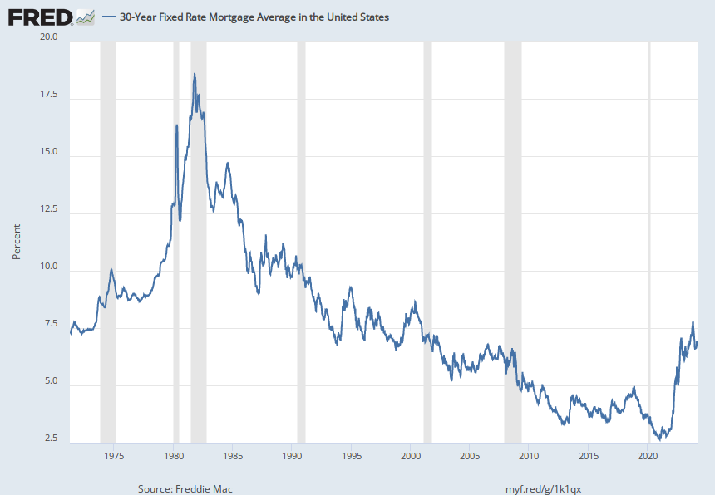
Notes:
Source: Freddie Mac Release: Primary Mortgage Market Survey Units: Percent, Not Seasonally Adjusted Frequency: Weekly, Ending Thursday On November 17, 2022, Freddie Mac changed the methodology of the Primary Mortgage Market Survey® (PMMS®). The weekly mortgage rate is now based on applications submitted to Freddie Mac from lenders across the country. For more information regarding Freddie Mac’s enhancement, see their research note.Data are provided “as is” by Freddie Mac®, with no warranties of any kind, express or implied, including but not limited to warranties of accuracy or implied warranties of merchantability or fitness for a particular purpose. Use of the data is at the user’s sole risk. In no event will Freddie Mac be liable for any damages arising out of or related to the data, including but not limited to direct, indirect, incidental, special, consequential, or punitive damages, whether under a contract, tort, or any other theory of liability, even if Freddie Mac is aware of the possibility of such damages.Copyright, 2016, Freddie Mac. Reprinted with permission. Freddie Mac, 30-Year Fixed Rate Mortgage Average in the United States [MORTGAGE30US], retrieved from FRED, Federal Reserve Bank of St. Louis; https://fred.stlouisfed.org/series/MORTGAGE30US, April 11, 2024.

Slide 31
Predictions 2024
Dollar Volume about the same as 2023
Interest Rates won’t fall as previously expected
Fannie Mae 30-year mortgage rates to be at
6.4 % by the end of 2024, compared to an earlier forecast of 5.8%.
People less likely to give up their Sub 4% rate move up.

Slide 32
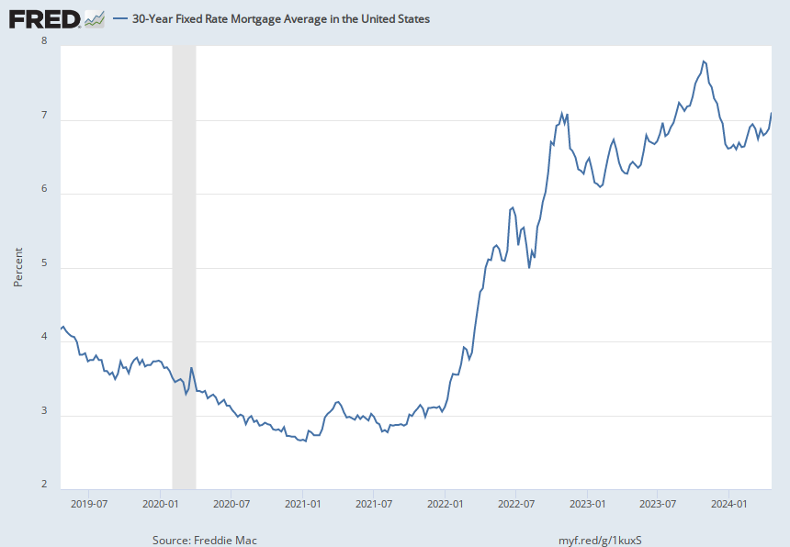
Notes:
Source: Freddie Mac Release: Primary Mortgage Market Survey Units: Percent, Not Seasonally Adjusted Frequency: Weekly, Ending Thursday On November 17, 2022, Freddie Mac changed the methodology of the Primary Mortgage Market Survey® (PMMS®). The weekly mortgage rate is now based on applications submitted to Freddie Mac from lenders across the country. For more information regarding Freddie Mac’s enhancement, see their research note.Data are provided “as is” by Freddie Mac®, with no warranties of any kind, express or implied, including but not limited to warranties of accuracy or implied warranties of merchantability or fitness for a particular purpose. Use of the data is at the user’s sole risk. In no event will Freddie Mac be liable for any damages arising out of or related to the data, including but not limited to direct, indirect, incidental, special, consequential, or punitive damages, whether under a contract, tort, or any other theory of liability, even if Freddie Mac is aware of the possibility of such damages.Copyright, 2016, Freddie Mac. Reprinted with permission. Freddie Mac, 30-Year Fixed Rate Mortgage Average in the United States [MORTGAGE30US], retrieved from FRED, Federal Reserve Bank of St. Louis; https://fred.stlouisfed.org/series/MORTGAGE30US, April 19, 2024.

Slide 33
Dollar Volume will be about the same
Not only because of Interest Rates
Because of
INSURANCE PREMIUMS

Slide 35
Average Premium for a $300,000 in Louisiana is $5710*
Average Premium for a $300,000 in USA is $2,151*
Additional Cost of Insurance for LA is $3,559 or about $300 /month
At 7% interest on a 30-year mortgage
$300 per month gets you about $45,000
*Bank Rate Website

Slide 36
Median Prices to Remain Unchanged in 2024
Cost are Stabilizing
Decreases in Volume will contribute to slowing increases
Inventory for 2024
Will stabilize days on Market and
Months’ Supply should Stabilize

Slide 37
New Development

Slide 38
Benton at Magnolia Woods | Harvest Companies • Location: Highland Road and Magnolia Woods • Total Lots: 74
• Price Range $170s - $300s
• Home size/living area: 1,700 – 3,500+ SF
• Amenities Highland Rd Corridor. Walkable access to a family-friendly commercial district. Ample green space and a beautiful community pond

Slide 39
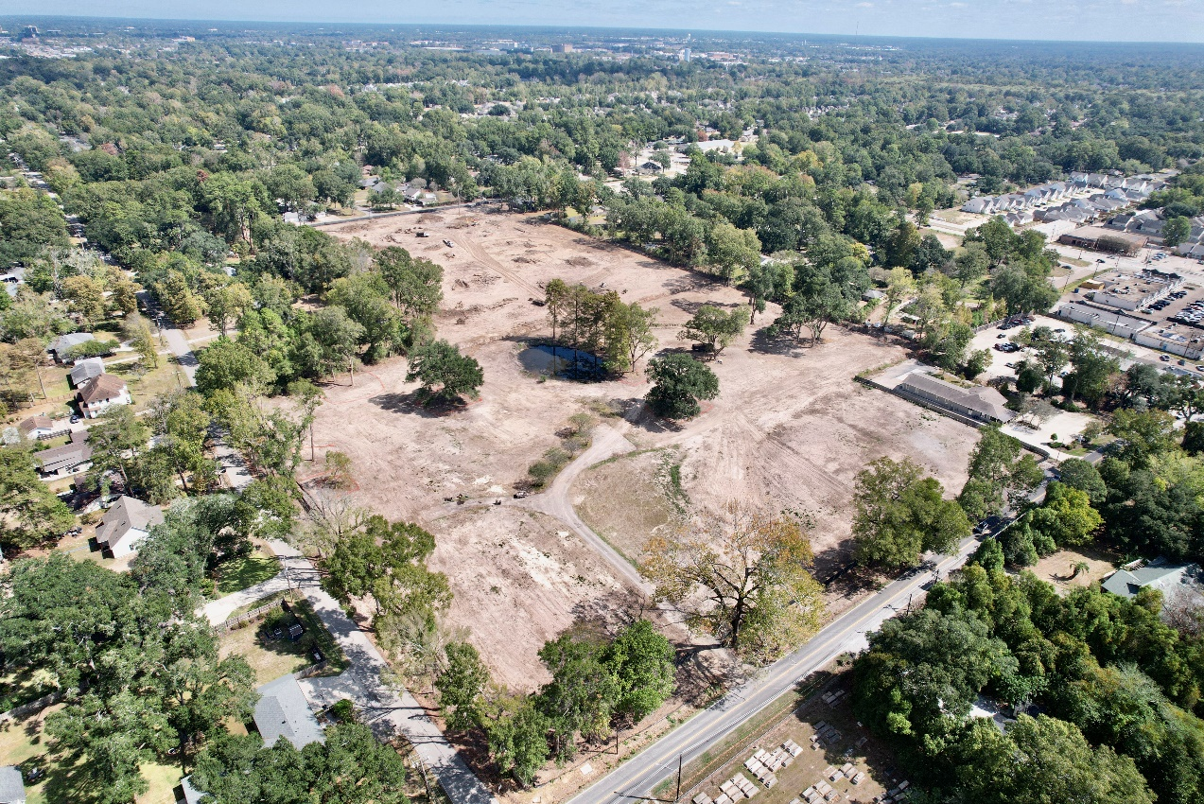
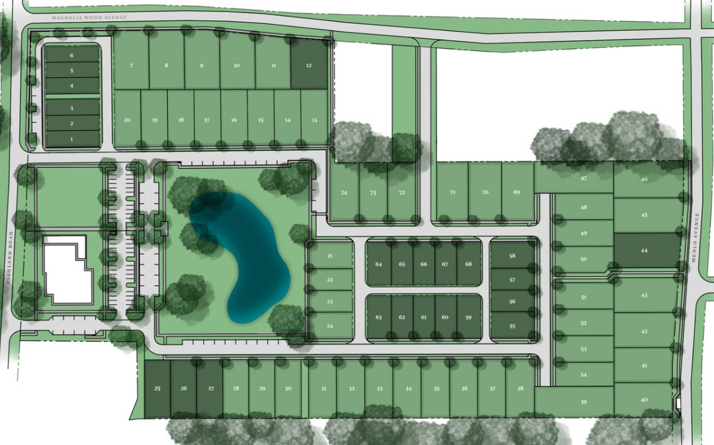

Slide 40
Highlake | Harvest Companies
• Location: Corner of Claiborne & Edmund Hawes
• Total Lots: 18
• Price Range of lots: $500s
• Home size/living area: 3,500 - 7,500+ SF
• Currently for sale
•Amenities: One-acre homesites just off Highland Road. Custom Estates located in a rare countryside setting. Balance of seclusion and convenience of location

Slide 41
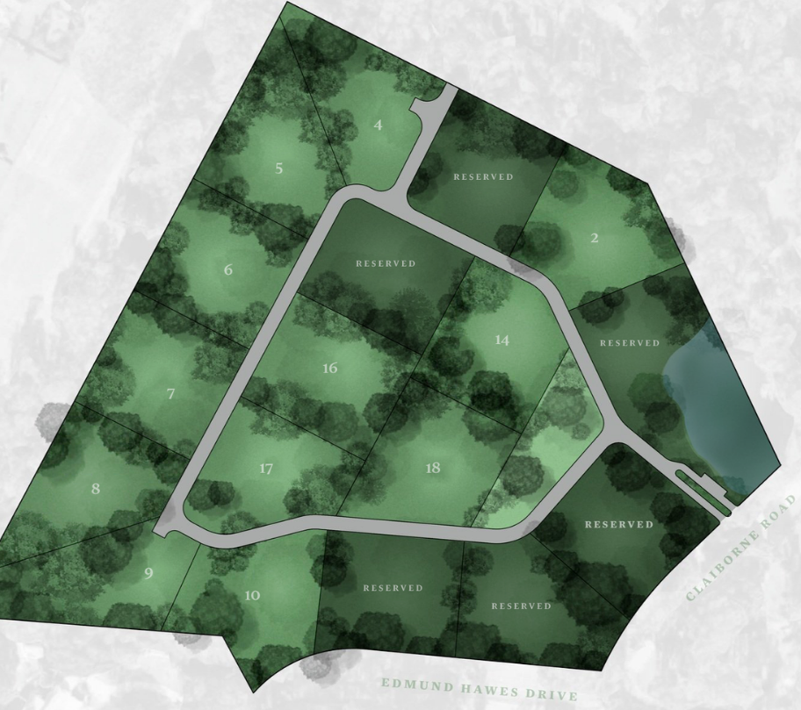
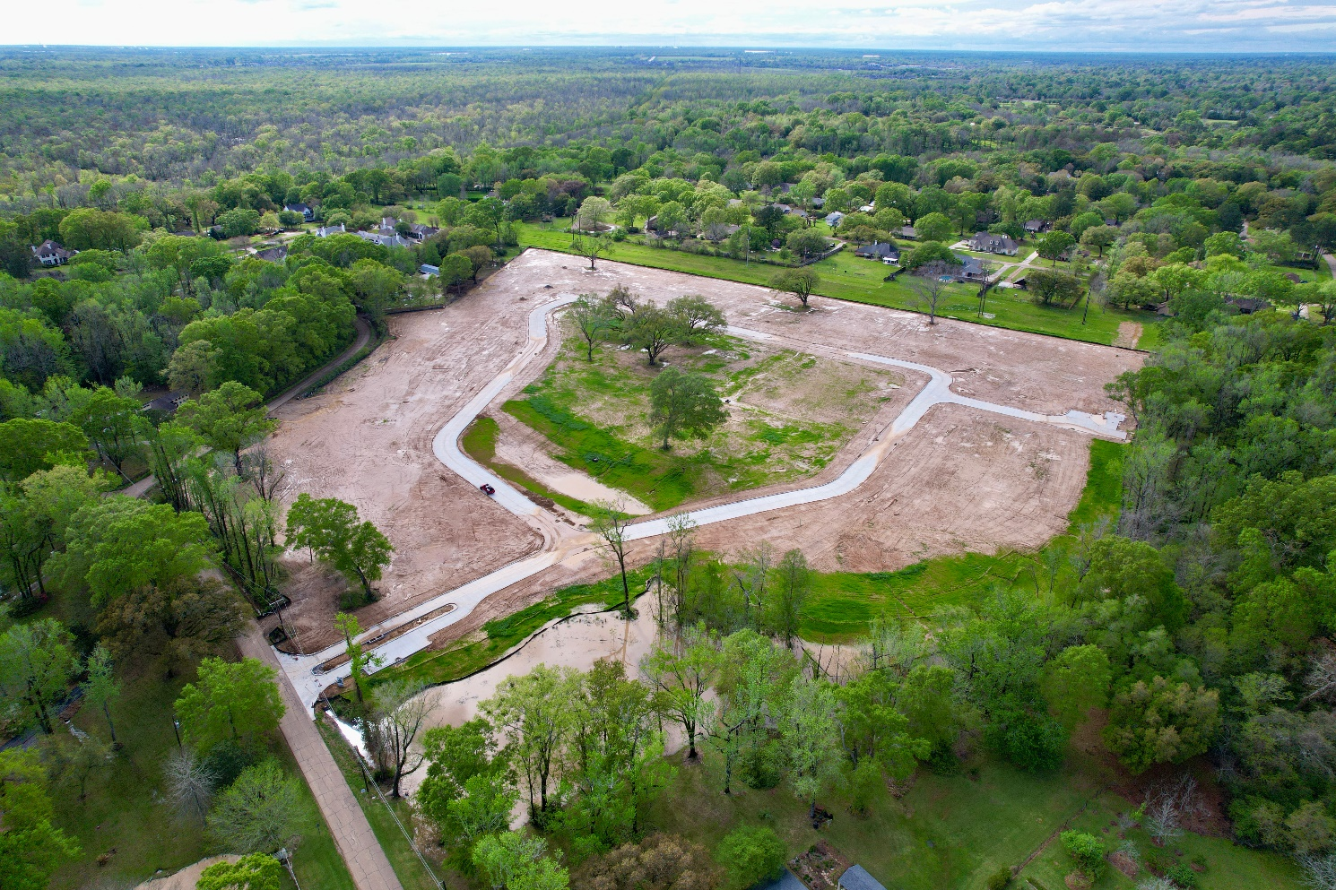

Slide 42
The Oaks at Moss Side | Enquest and Svendson
• Location: Moss Side Lane
• Purchased: 1-23-2024 for $6,750,000
• 14.23 acres, about $475,000 per acre
• 19 Total Lots, about Half an Acre 100’Front Ft
Lot price not yet released
• Currently Under construction
•Amenities: Gated community, Excusive Custom Homes, Heavily restricted.

Slide 43
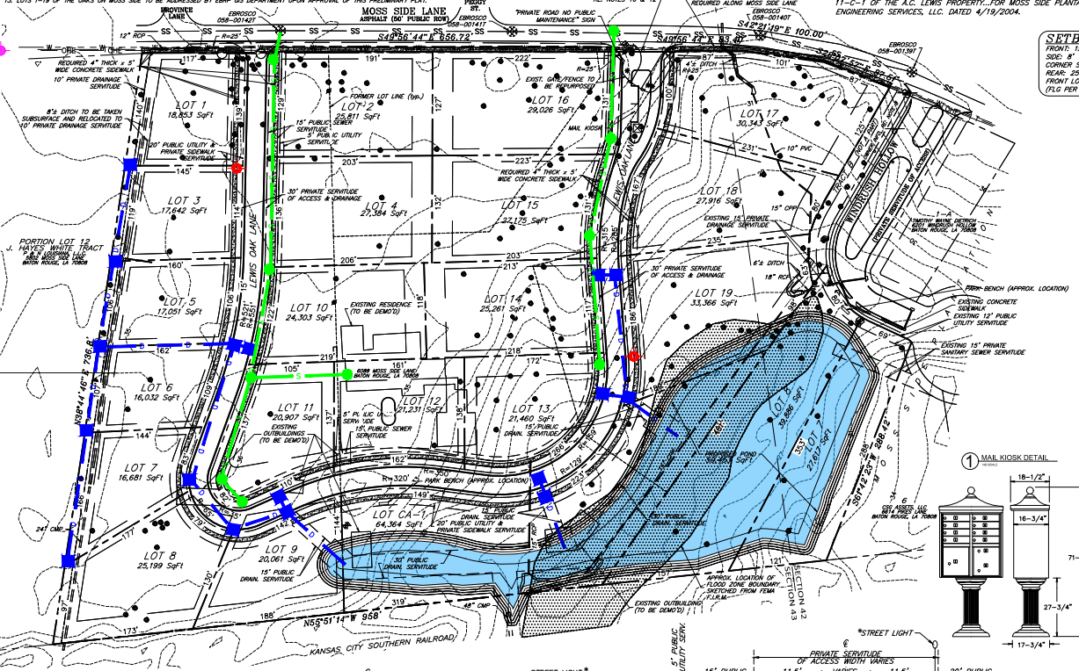

Slide 44
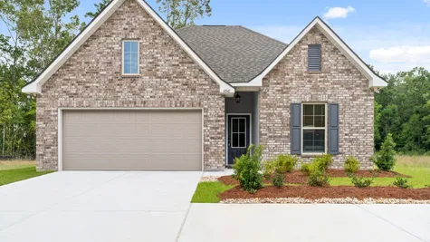
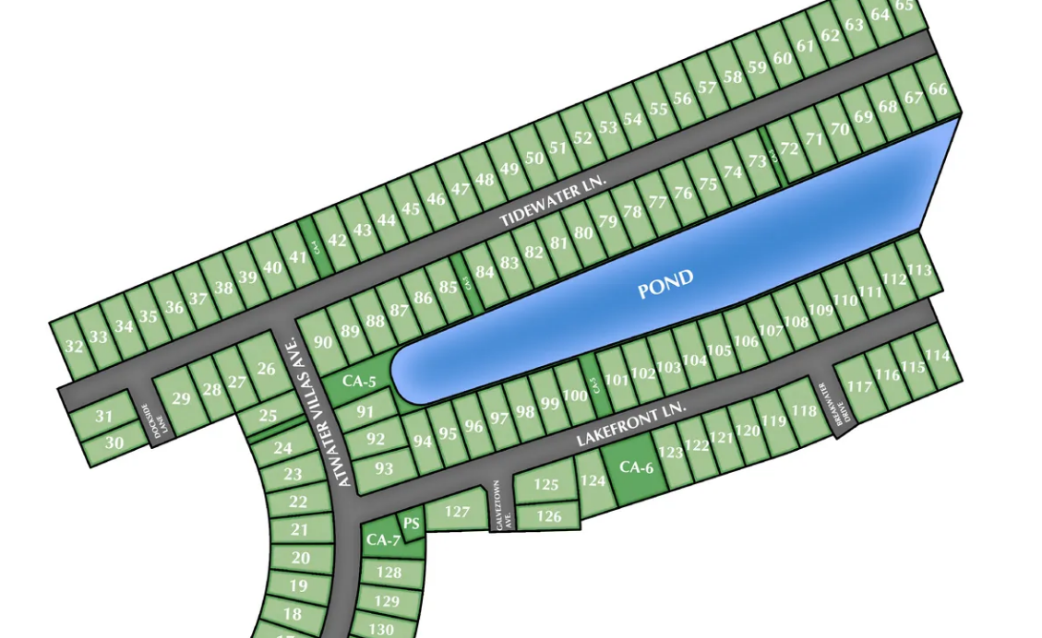
Atwater Villas | DSLD Homes
• Location: River Road
• Total Lots: 149
• Price Range lots/home price: $260s – $320s
• Living Area 1463 SF –2072 SF
•Amenities: Near Levee, convenient access to LSU and downtown, walking trails. pickleball courts

Slide 45
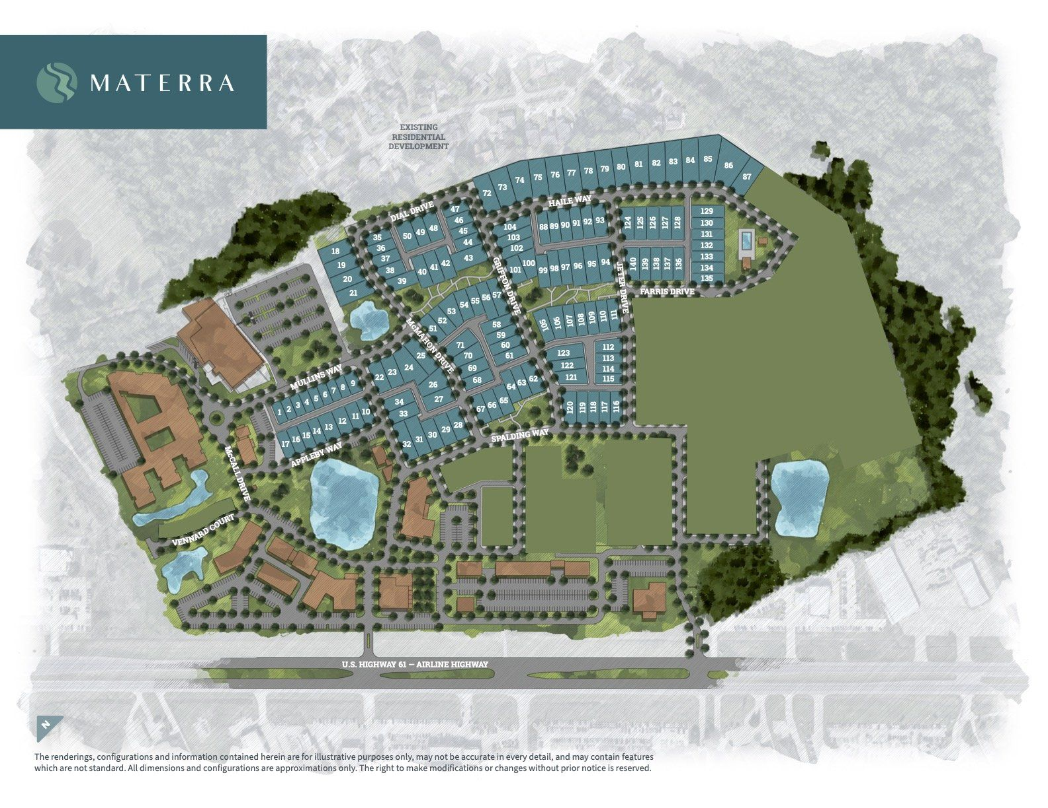
Materra Level Homes New Phase C
• Location: Woman’s Hospital campus
• Lot Count: 79 in Phase 1
• Home Size: 1,470 to 3,000+ SF
• Home Price: from $380s – $600s • Date Available Phase 2 early 2025 • Amenities: The BASIS Charter School, Future Community Pool an Playground, Stocked Fishing ponds, Future Commercial space: Shopping and Dining

Slide 46
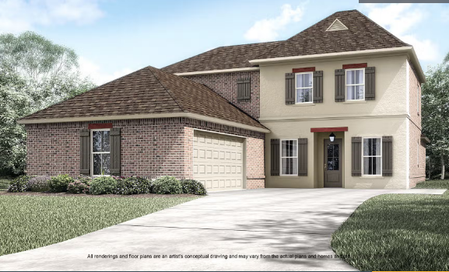
Belle Savanne At Dutchtown | Level Homes Final Phase
• Location: Geismar, Off Old Jefferson
• Lot Count: 95 lots in final phase
• Home Size: 1,757 to 3,210 SF • Home Price: from $360s •
• Amenities: Resort-style community pool and cabana. Walkable community with scenic lakes and green space
Phase 1 and Phase 2 SOLD OUT

Slide 47
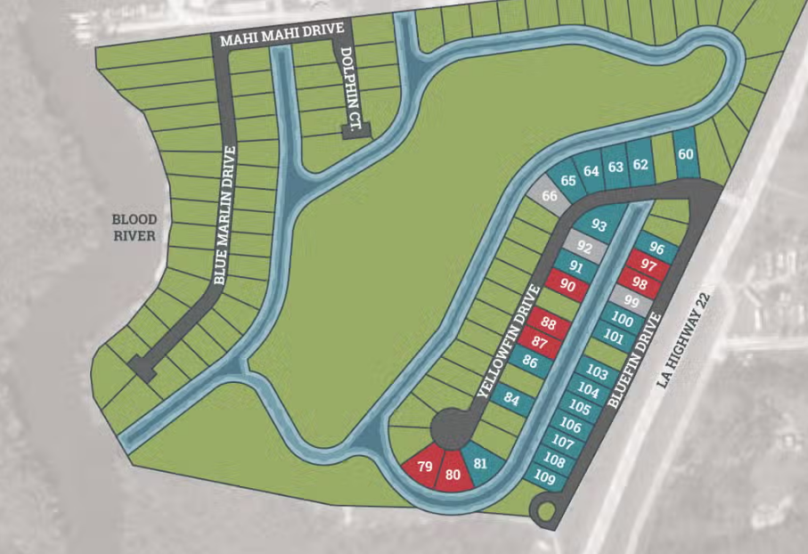
Bruce’s Harbor | Level
• Location: Springfield
• Lot count: 43
• Home Price: from $360s
• Home Size: 2,000 to 3,210
• Amenities: Private, gated community. Premium water-front homesites with direct access to Blood and Tickfaw Rivers

Slide 48
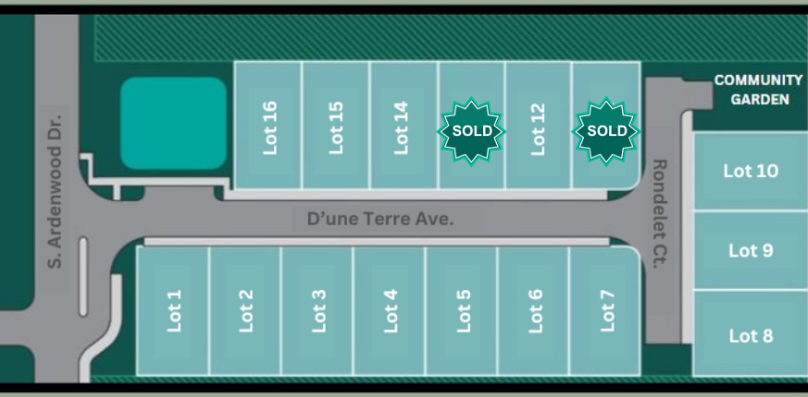
D’une Terre | LJP Contractors
• Location: West Ardenwood between Government & Florida
• Total Lots: 16
• Homes Sizes: 1,275 to 2,230 SF • Lot Sizes: 32’ to 55’ X 95’ to 100’ • Home Price Range: Start $300’s
Move-in Ready Homes Fall 2024
• Amenities: Gated, 2 Car Garage, 3 & 4 Bedroom Homes, Community Greenspace.
Five floor plans to choose from.

Slide 49
Greystone, 7th Filing |Derk Lockhart
• Open to builders
•Location: Somerset Hills Court Livingston
• 65 Total Lots
•39 active lots and 26 pending lots
• Lot prices from $85,000 - $140,000
•Amenities: Greystone Golf and Country Club, lake and golf course views.

Slide 50
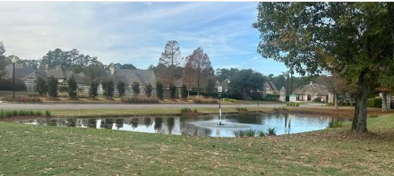
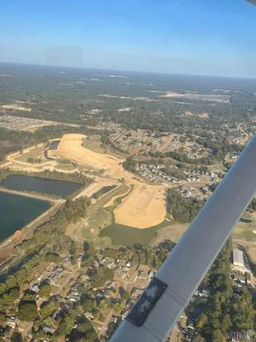
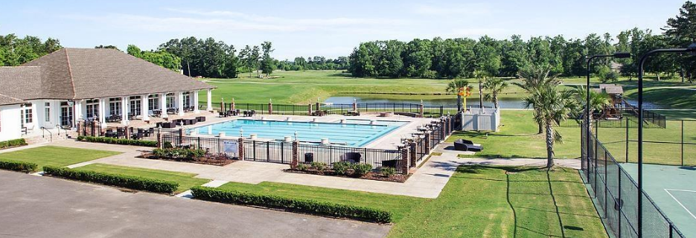

Slide 51
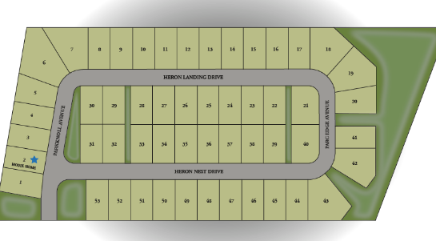
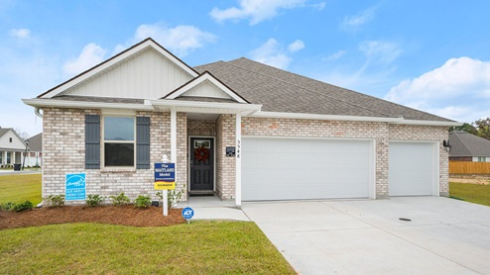
Heron Pointe | D.R. Horton
• Location: Parkview Oaks BR
• Total lots: 53
• Lot Sizes: 60’ x 110’
• Home Sizes: 1,948 - 2,273
$325,000 to $375,000
• Amenities : Walking trail to convenient playground, sidewalks, curb and gutter, and community green space.

Slide 52
Village at Magnolia Square / Tower Capital
102 Acres purchased 3/31/2022 for $1,850,000.00
Adding 257 lots to the development
Phase 4, 93 Lots 50’ x 120’ Alvarez Construction
Phase 5, Parts 1 – 5, 157 Lots of various sizes from rear alley load garden home to large estate size lots for custom homes. 100 of which are under contract to Bardwell Construction
The new phases will contain 27.8 acres of Green Space
When completed the development will contain 485 lots
Spending $450,000+ to upgrade and add new Common Area elements

Slide 53
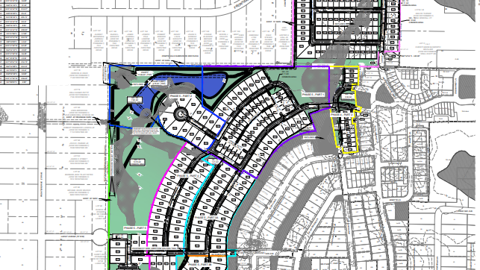

Slide 54
The Lakes at Harveston | Fetzer and Mike Wampold
• Location: Bluebonnet Blvd. near Nicholson Drive
Harveston Way Extension / Roundabout 6-9 Months
• Number of Lots: 186 in Phase 1
• Lot Price(s) from $108,000
• Lot Size: 45’ x 120’ or 60’ x 140’, Home Size: 2,000 to 3,800/sf
• Price Range: $599,900 to $1,000,000+
• Additional Features: Community Center overlooking the 60-acre Harveston Lake with fountain, Community Clubhouse, Fitness Center, Cabana with Grill, Pool and Splash Pad, Playground area, Pickleball courts and arbor, park area with arbor and firepit, Mail Center, Multi-Use Trails and Walks

Slide 55
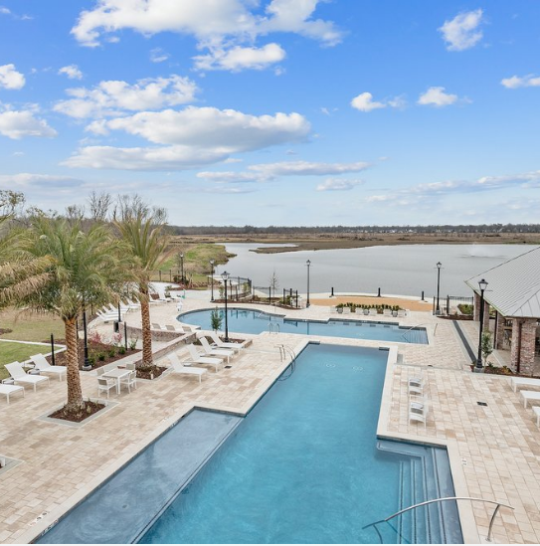
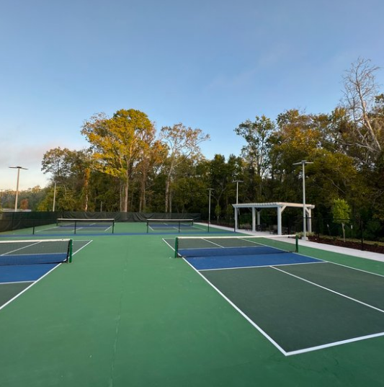

Slide 56
Long Farm Village | Developer: Russell Mosely
• Location: Airline Hwy, Jefferson Hwy, and Antioch
• A 237-acre master planned Retail, Office, Multifamily,
Senior Living, 100 bed nursing home planned
• Single Family; Construction of the 5th Filing, Part A (43 lots)
completed in 2023. Lot prices average $169,000.
• New home prices range from $600,000 to $1,400,000;
custom home plans designed by local architects
• Overall project plans more than 300 detached SFR.
• Amenities: Pool/Clubhouse, parks, benches, bike rack, athletic field, walking loop consisting of paved walks around residential phases (including 2 lakes), privacy brick wall along Jefferson

Slide 57
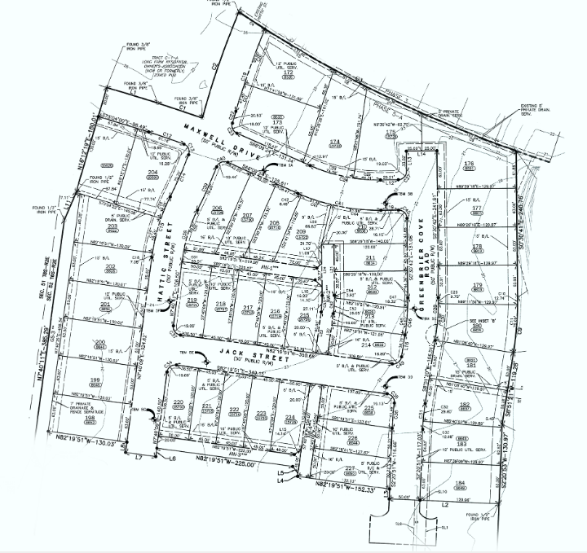
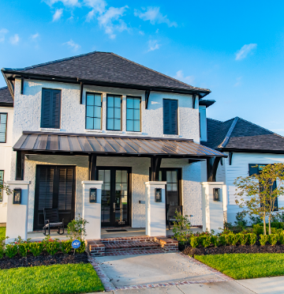

Slide 58
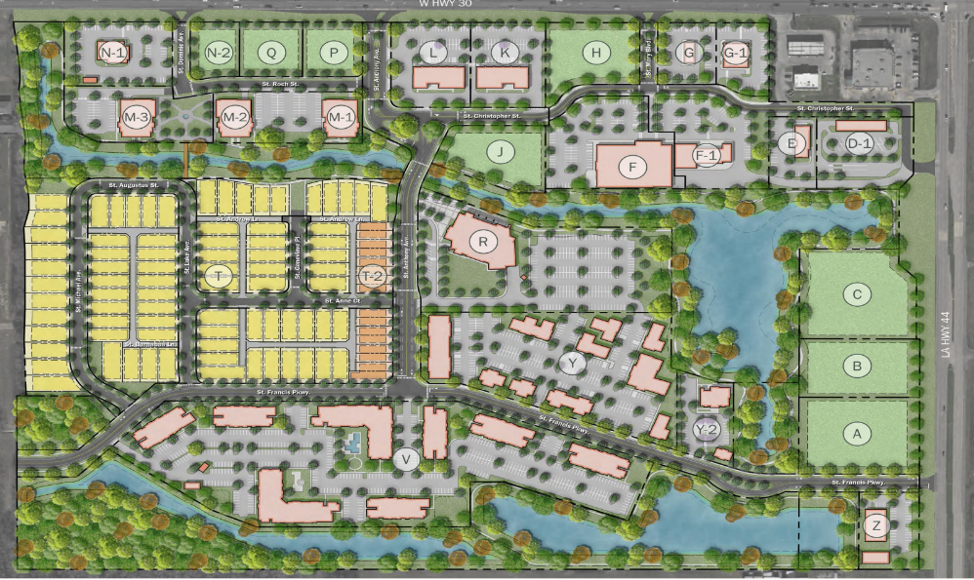
Heritage Crossing
Double D of Louisiana
LA Hwy 44 and LA Hwy 30, Ascension
Closed on Land 4-23
Number of Lots: 79 SFR and 17 TH
Lot Size: 45’ to 55’ x 120’ to 140’
Residential: 79 SF Lots ($600s -$700s)
17 to 48 Townhome Lots - $400s
Multifamily The Waters Edge 300 units
Retail Development Completed
Alexander’s Heritage Market
Price LeBlanc Preforming Arts
Office 60,000 SF
Expansive lakes with scenic walking trails, verdant green spaces, dedicated bike lanes, and charming pocket parks

Slide 59
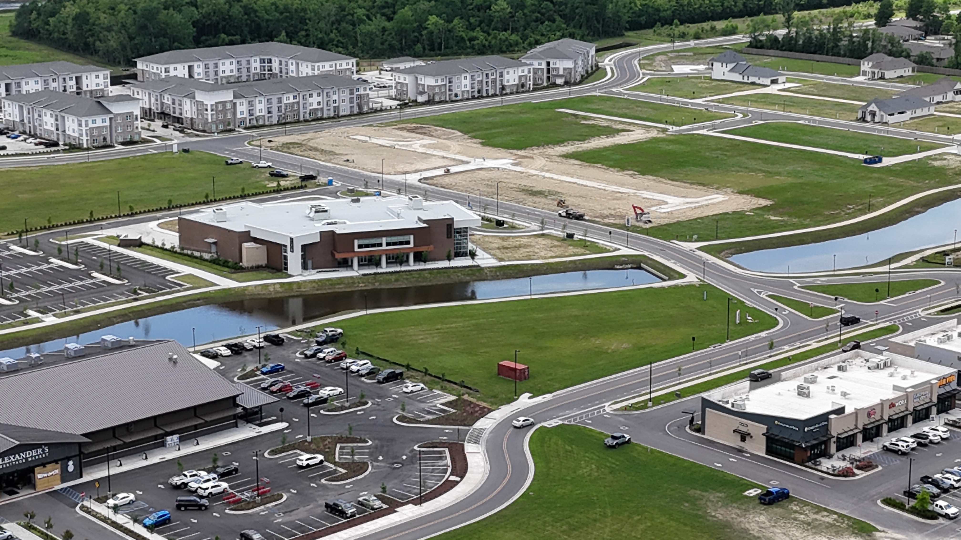

Slide 60
Rouzan | Engquist Development, Final Phase
Location: Glasgow Avenue at Perkins Road
• Lot Count: Approx. 450+ SFR lots
• Home Size: 1,500 to 6,000+ SF
• Home Price: from $590s to $1M+
• Lots for sale starting from the $160s
• Completed Homes: 200+ occupied
• Features/Amenities: Sprouts Farmers Market, Pizza Artista, Ocean Nails, Community Clubhouse with Pool and Fitness Center, Silo Farm with Community Planter Boxes, Outdoor Fitness & Children’s Playgrounds, Waterfront Boardwalk

Slide 61
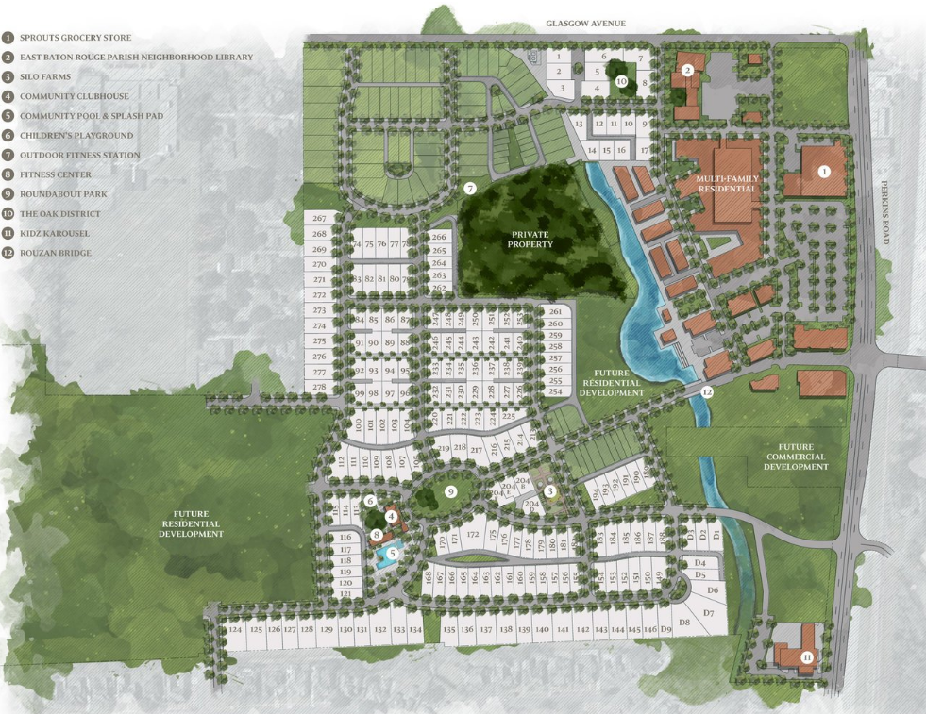
ROUZAN FUTURE PROJECTS
OLOL Physicians Group
Kidz Karousel
EBR Parish Neighborhood
Library
More Parks & Greenspaces

Slide 62
THANK YOU

